Slide 1

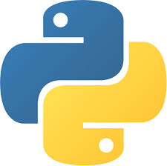

AI Master Class series – Day 1
Overview of this course | Create your own chatbot

Slide 2
Announcement
Attendance link will be available around
8:30 PM.

Slide 3
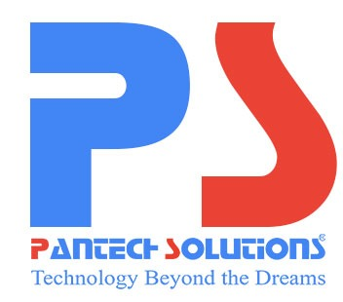
About Pantech.
Profile
Established on 2004 | 7 Branches | 100+ Team
R & D
Manufacturer of Lab equipment‘s & Development boards | Industrial & Funded projects | Online retail store of engineering products and projects
Online Retail Store
Lab equipment, Engineering Kits, Components,
Sensors and All level Projects
Training
2000+ Workshops | 250+ FDP | 100+ Seminars
Vision
“To Gain Global Leadership in providing Technological Solutions through Sustained Innovation”

Slide 4
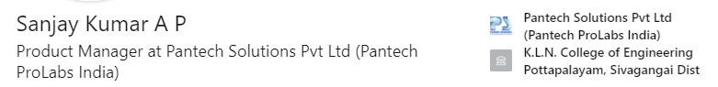
About Me.
My Expertise
AI BOARDS: NVidia Jetson Boards, Beagle bone, PYNQ FPGA, Google coral, Raspberry Pi
TECHNOLOGY: AI, Brain Computer Interface(BCI), Robotic Operating System(ROS), IoT,
Autonomous Robot design
PROGRAMMING: Python, Matlab, C
MICROCONTROLLER: 8051, MSP430

Slide 5
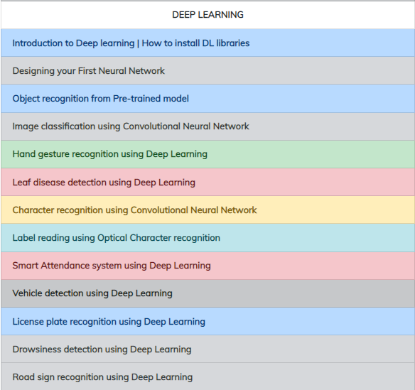
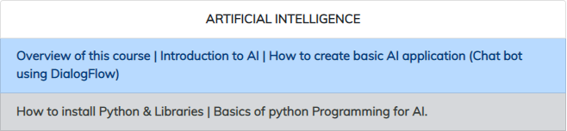
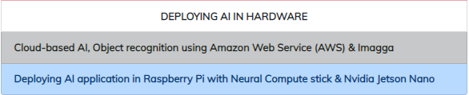
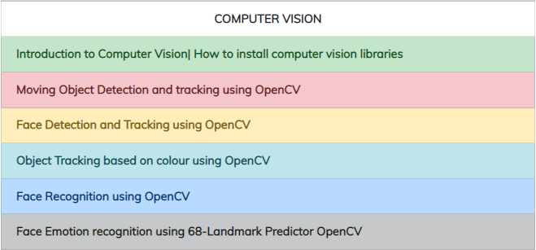
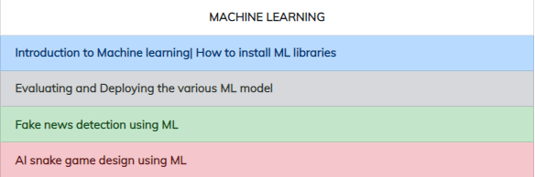
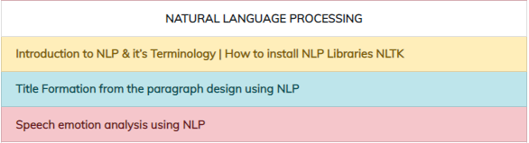
What u will learn.

Slide 6
Prerequisites for this Course
Windows 10 Laptop with Good Internet
No basic knowledge is required.

Slide 7
Day-1 Agenda.
01.
02.
03.
Introduction to AI
Applications of AI
Creating your Chatbot
04.
05.
Integration
Q & A Session
What is AI | Why AI | How AI
AI in various domain
DialogFlow | Creating Agents, Intents
Integrating your chatbot with webserver & Mobile assistance

Slide 8

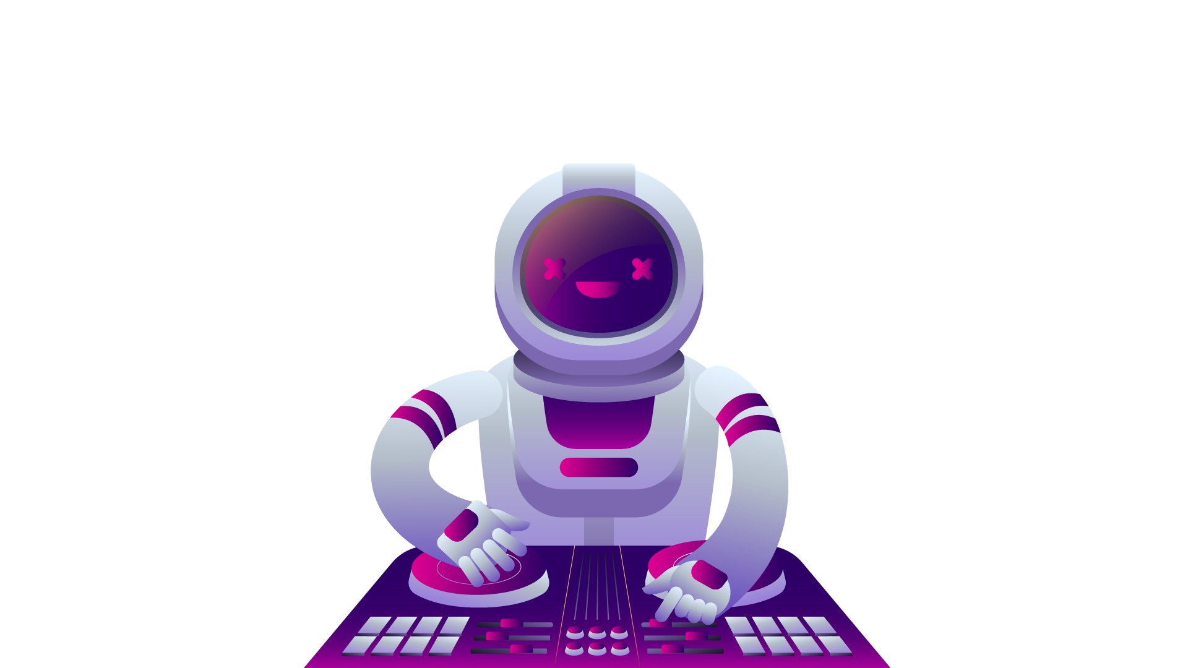
What is AI?.
Intelligence demonstrated by the Machines in contrast to Natural Intelligence delivered by Humans
Intelligence is given by feeding the experience of human to machines in the form of data
“AI WILL BE THE BEST OR WORST THING EVER
FOR HUMANITY.” – Elon Musk

Slide 9
Why AI?.
“Success in creating AI would be the biggest event in human history. Unfortunately, it might also be the last, unless we learn how to avoid the risks.” – Stephen Hawking
AI automates repetitive learning and discovery through data
AI adds intelligence
AI analyzes more and deeper data
AI achieves incredible accuracy
24x7
Reduces Man power

Slide 10
How AI?.
See & Recognize: Computer Vision & Deep learning
Eye - Camera
Analyze & Learn: Machine Learning
Sensing organs - Sensors
Listen & Speak: Natural Language Processing
Ear & Mouth – Mic & Speaker

Slide 11
Applications of AI

Slide 12
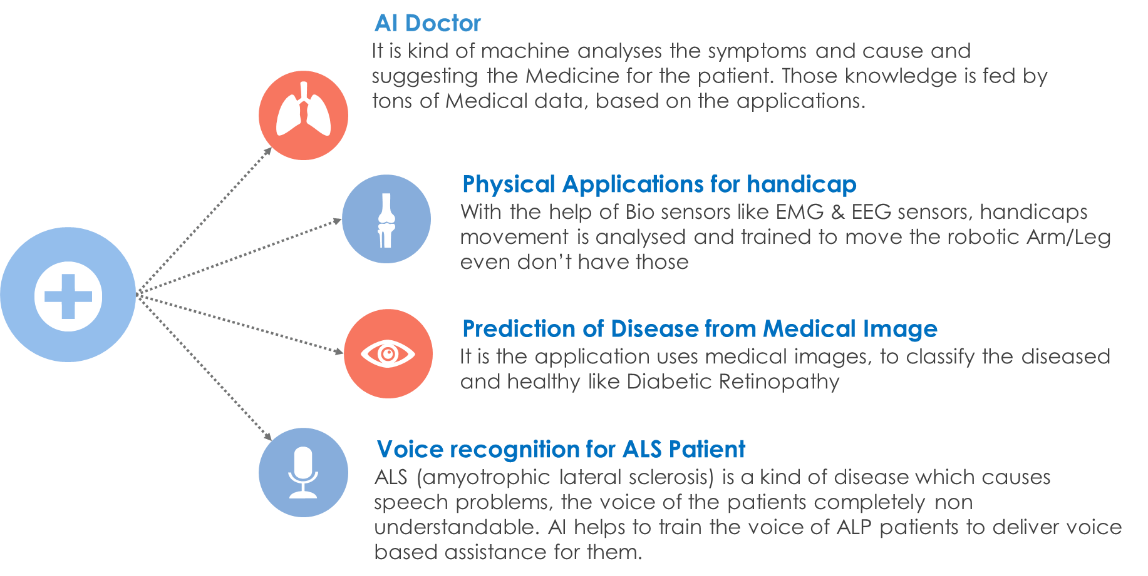
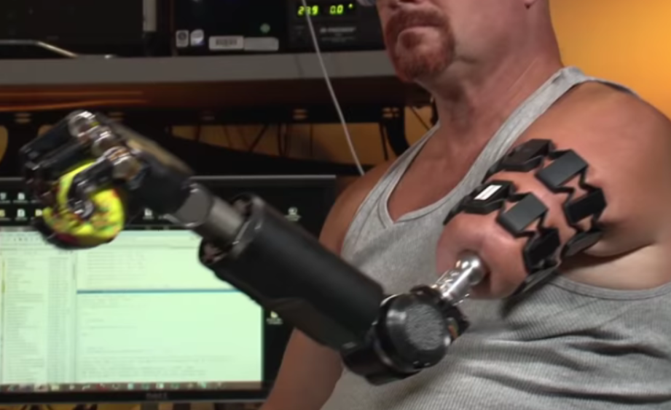
AI in Medical.

Slide 13
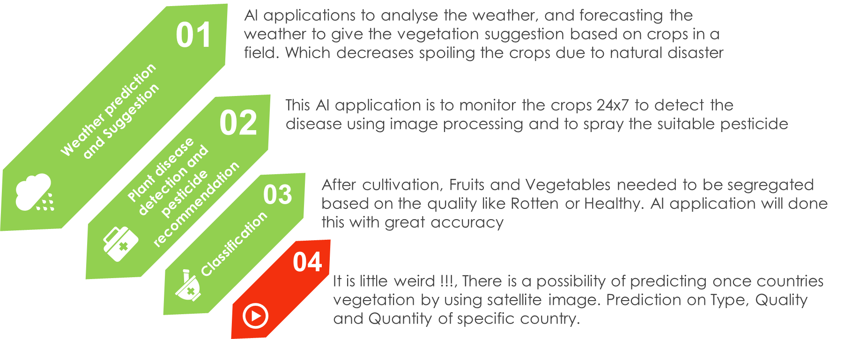
AI in Agriculture.

Slide 14
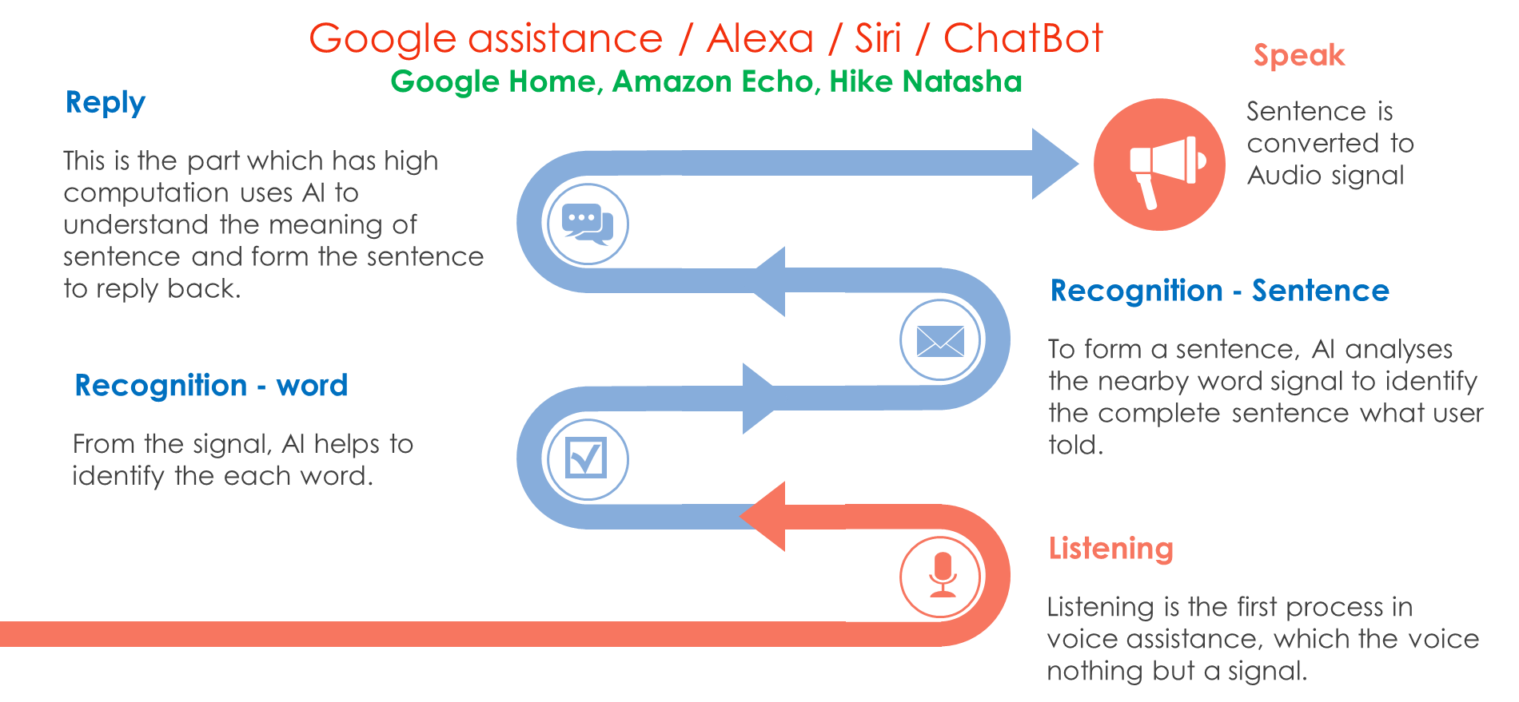
AI in Voice Assistance.

Slide 15
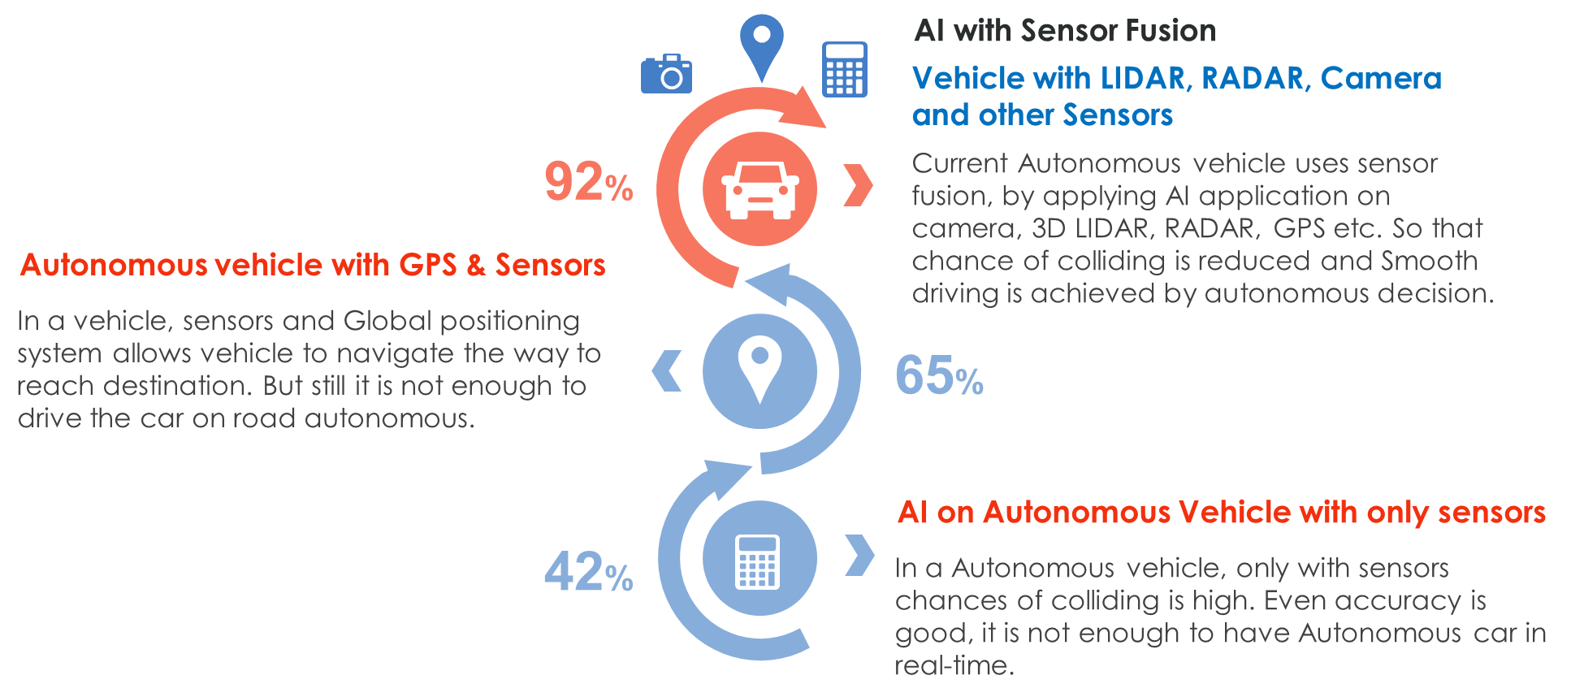
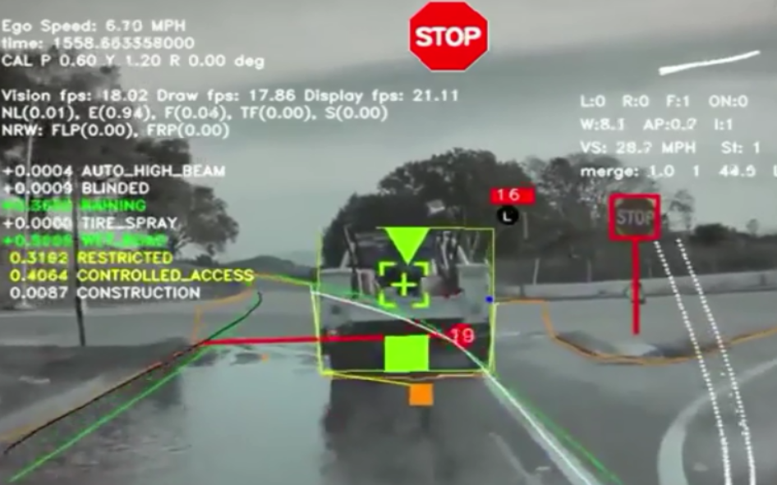
AI in Autonomous Vehicle.

Slide 16
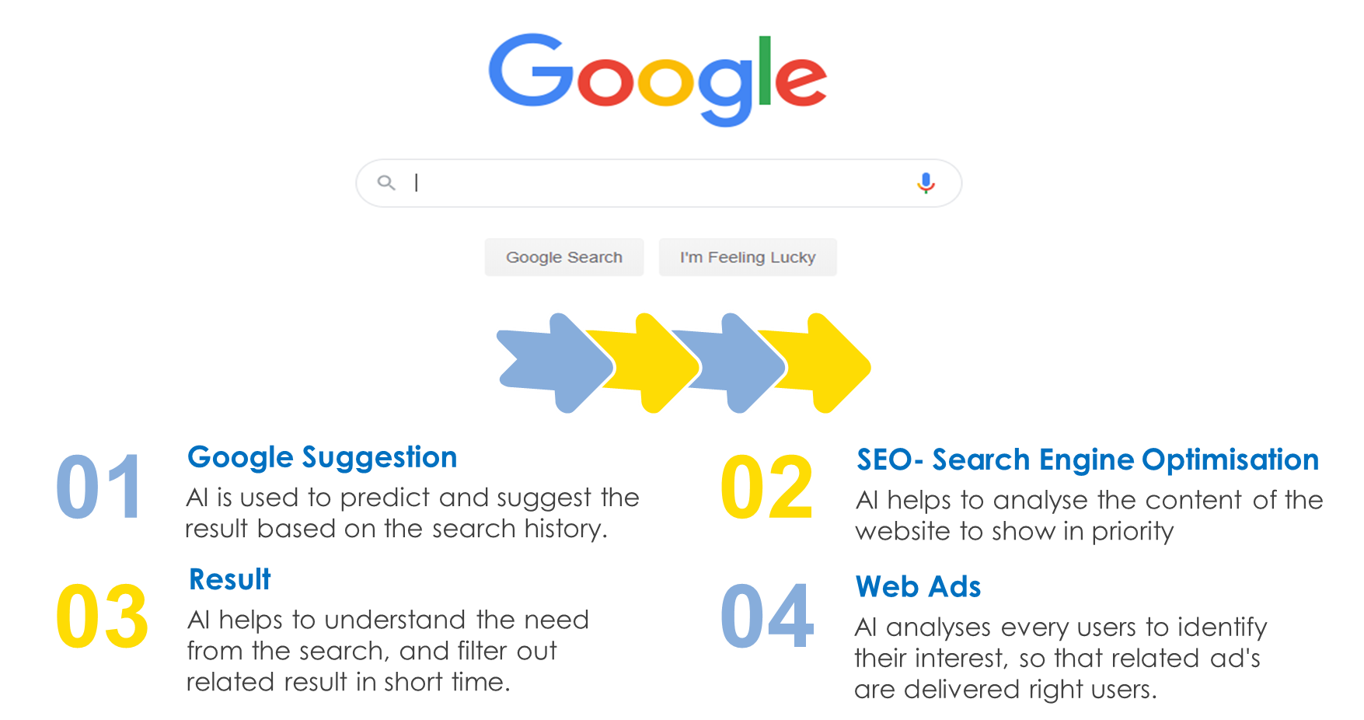
AI in Search Engine.

Slide 17
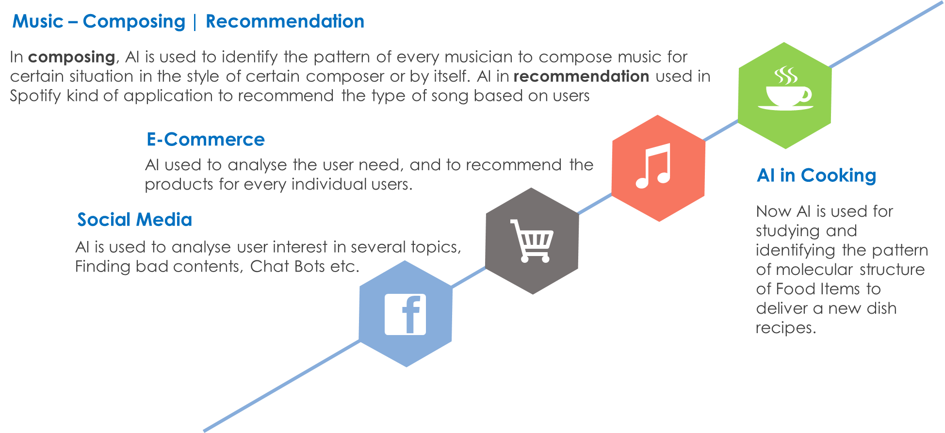
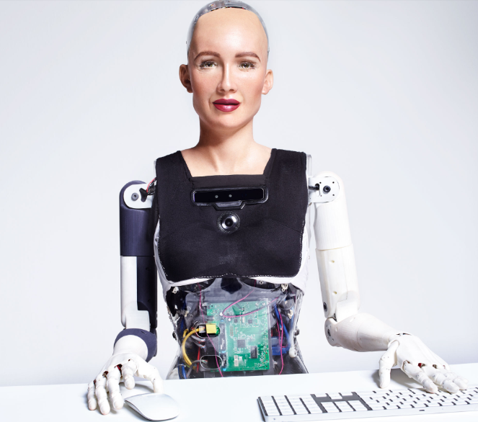
AI in Social Media & Other.

Slide 18
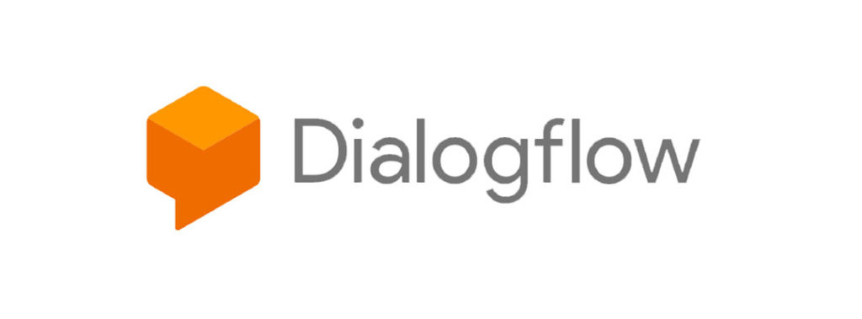
Dialogflow.
Dialogflow is a natural language understanding platform used to design and integrate a conversational user interface into mobile apps, web applications, devices, bots, interactive voice response systems, and so on.
Small Talk
Intents
Entity
Integration
Pre built Agents

Slide 19
Applications of Chatbot.
Voice Assistance
Social Media
Customer Support
Helpdesk
Medical Assistance
Restaurant
Transportation
E-Commerce

Slide 20

Practical session

Slide 21
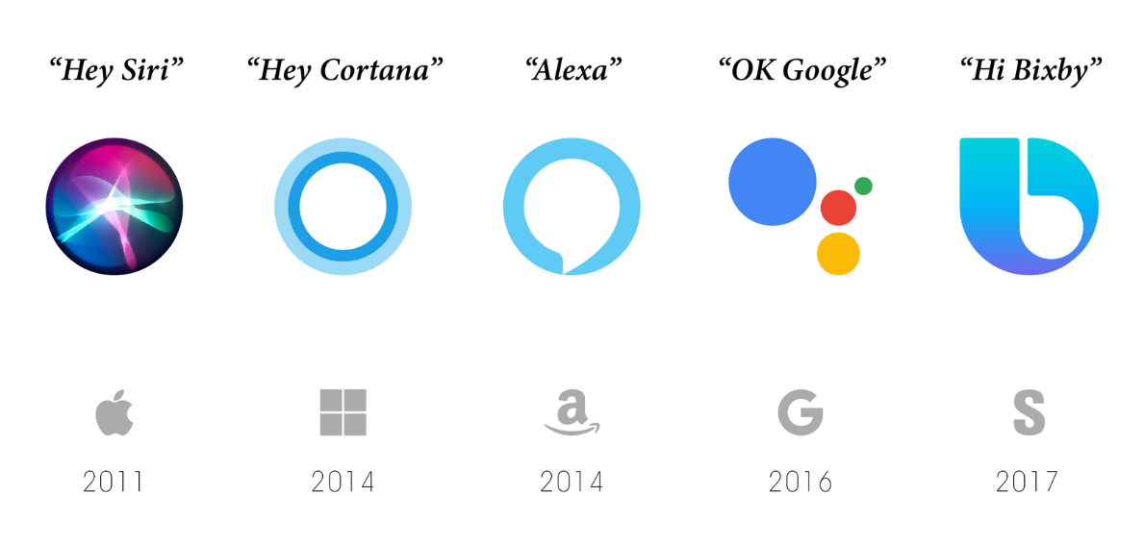
Q & A session

Slide 22
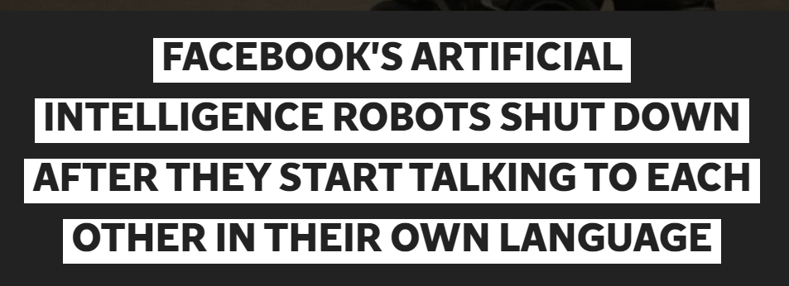
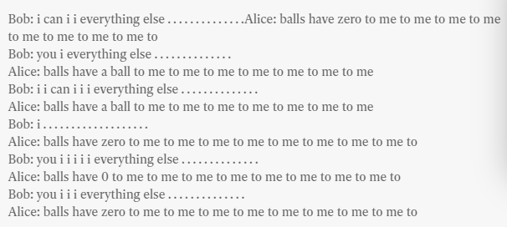
AI News – Day 1. 2017

Slide 23
Prerequisites for this Course
Windows 10 Laptop with Good Internet
No basic knowledge is required.

Slide 24
Thanks!
Tomorrow session
Do you have any questions?
sanjay@pantechmail.com
www.pantechsolutions.net
Python & Libraries Installation
Basic Python Programming

